Slide 1
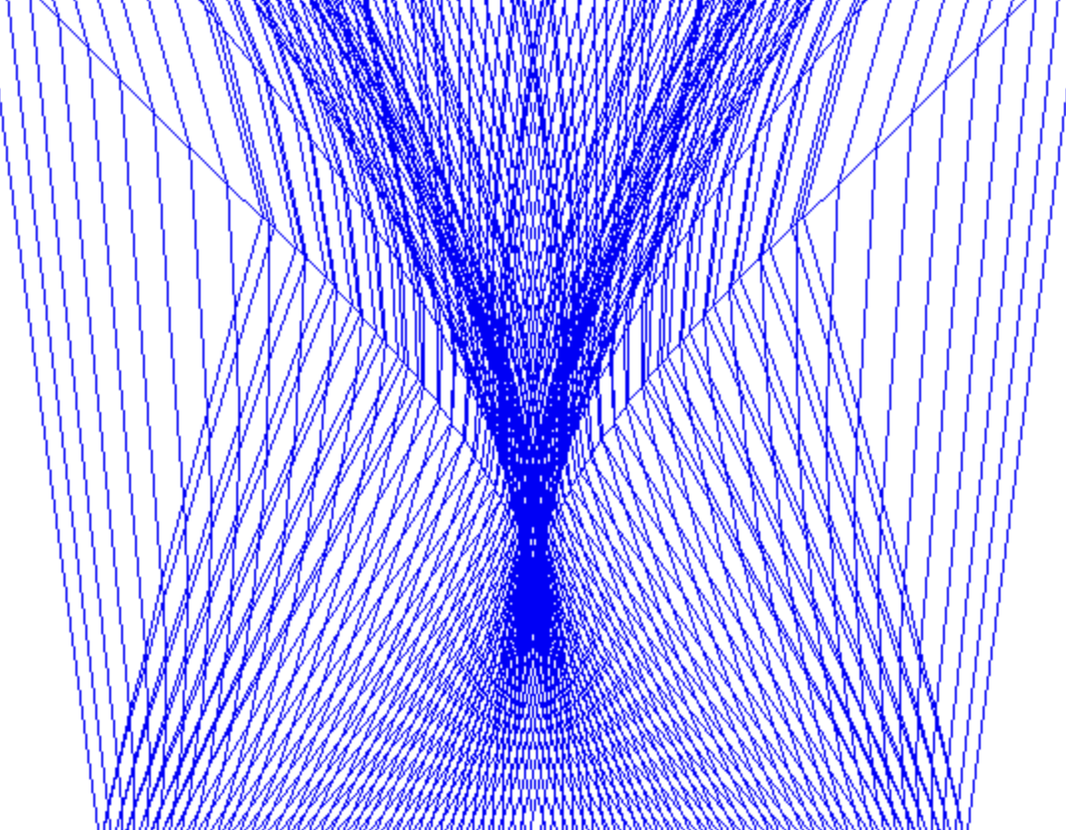
Physics-Informed Neural Networks for Hyperbolic Conservation Laws
Presented by
Sagar Prakash Barad, 2011137
Dr. Victor Roy & Dr. Subhasish Basak
Under the Supervision of

Slide 2
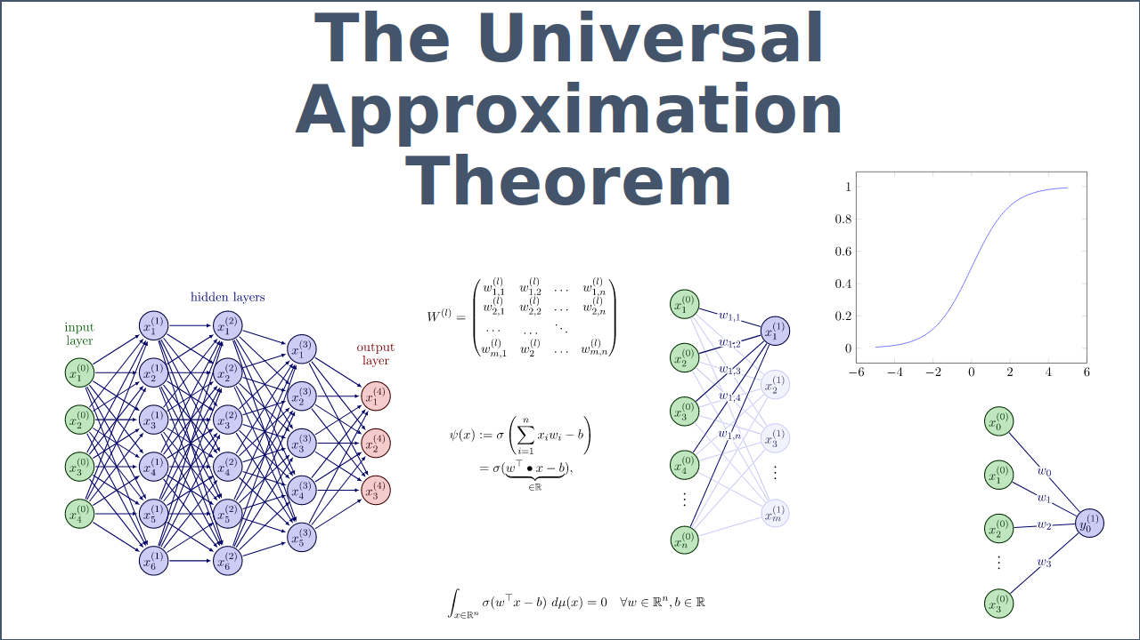
What is a Neural Network?
Ans: function approximator
Source: https://www.deep-mind.org/2023/03/26/the-universal-approximation-theorem/

Slide 3
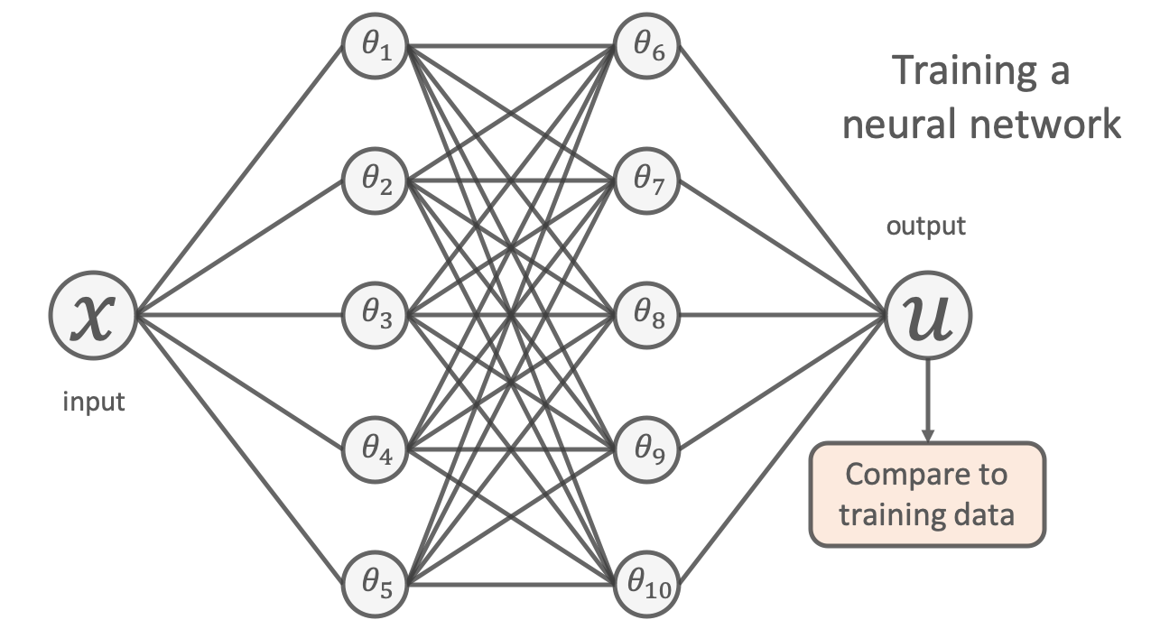
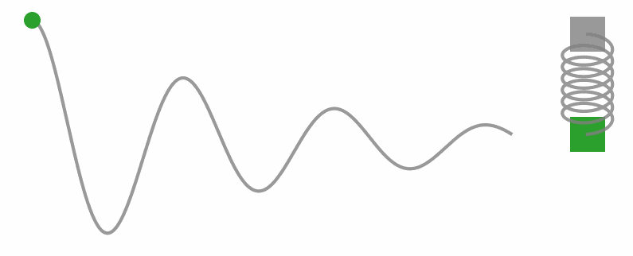
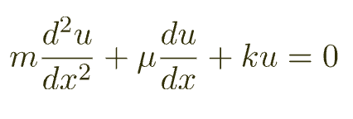
Can AI do Physics?
Specifically, can it approximate the solution to PDE or ODE, given sufficient data?
1D damped harmonic oscillator
uNN = usolution ??
Source: https://benmoseley.blog/my-research/so-what-is-a-physics-informed-neural-network/

Slide 4
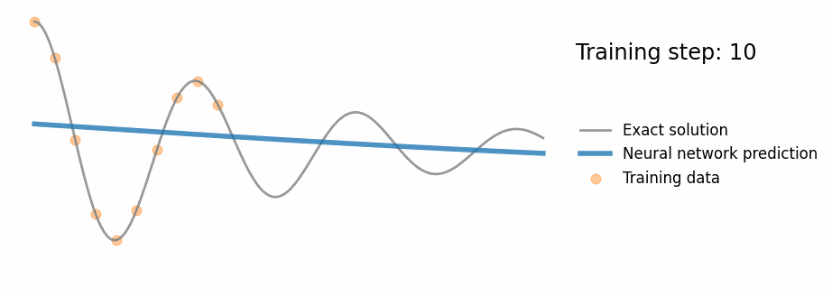
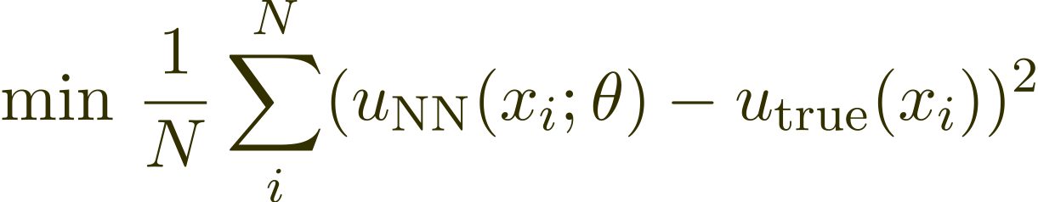
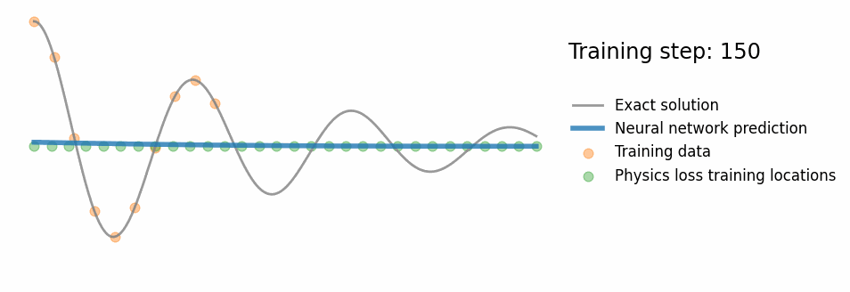
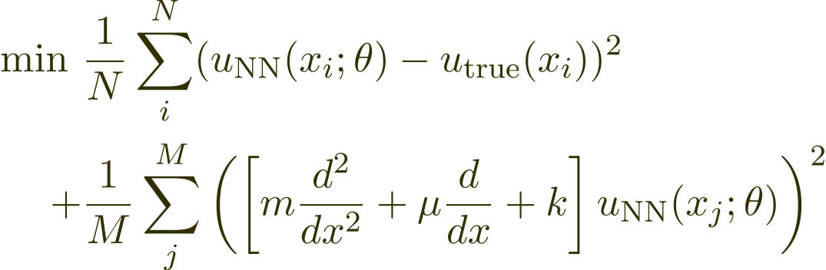
‘Naive’ Neural Network
“Data loss”
‘Physics Informed’ Neural Network
“physics loss”
Source: https://benmoseley.blog/my-research/so-what-is-a-physics-informed-neural-network/

Slide 5
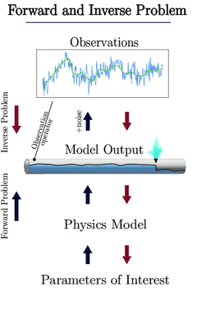
Physics Informed Neural Network (PINNs) can solve PDEs
Forward Problem
Given λ what is u(t; x) (Inference, filtering and smoothing or simply
data-driven solutions of PDEs)
Inverse Problem
Find λ that best describes observations u (ti; xj) (Learning, system
identification, or data-driven discovery of PDEs)
Source: Mücke, Nikolaj & Sanderse, Benjamin & Bohté, Sander & Oosterlee, Cornelis. (2021). Markov Chain Generative Adversarial Neural Networks for Solving Bayesian Inverse Problems in Physics Applications.

Slide 6
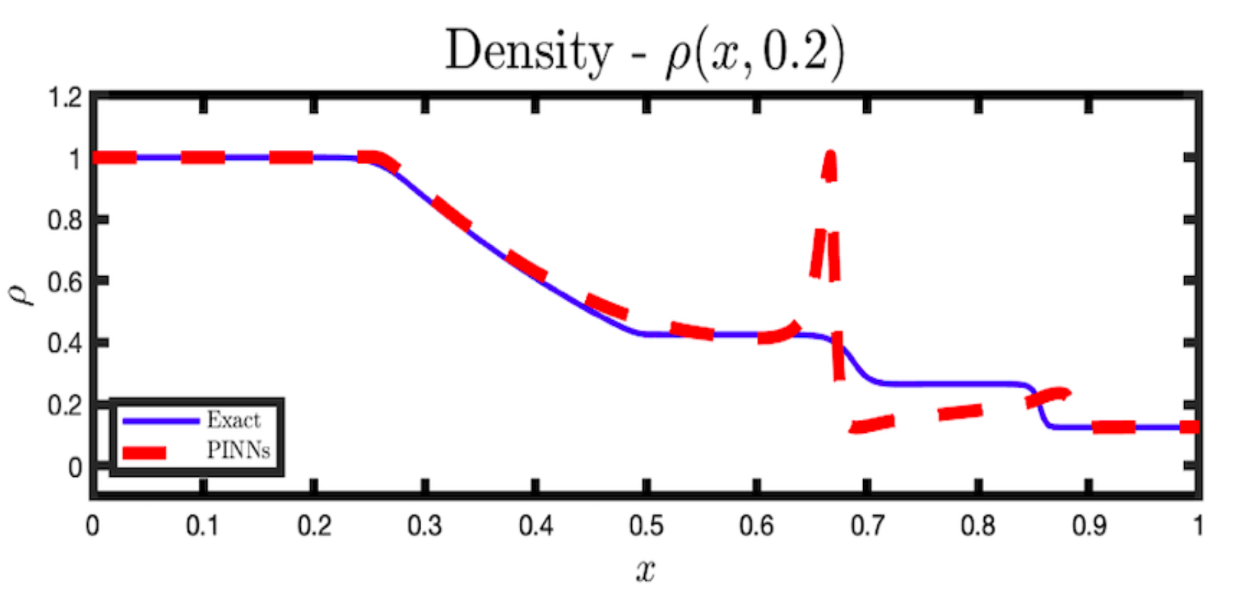
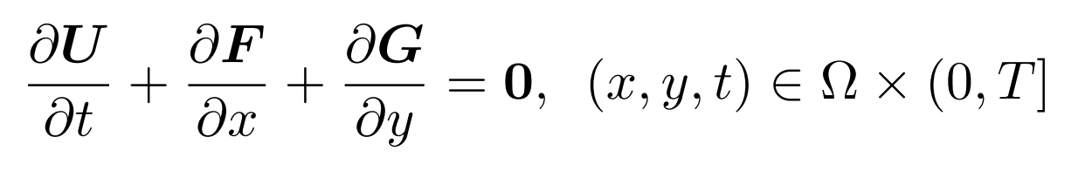
Want to
solve hyperbolic PDEs or hyperbolic conservation laws
Whose
Solutions are often discontinuous & non-differentiable
But
Solution to Sod Shock-Tube Problem
PINNs struggle to approximate discontinuous solutions of PDEs.
Because
Hyperbolic PDEs
Deep Learning frameworks use Automatic Differentiation
Which
differentiate the neural network with respect to the governing PDE, may not consistently resolve discontinuities that arise in solutions to hyperbolic conservation laws.

Slide 7
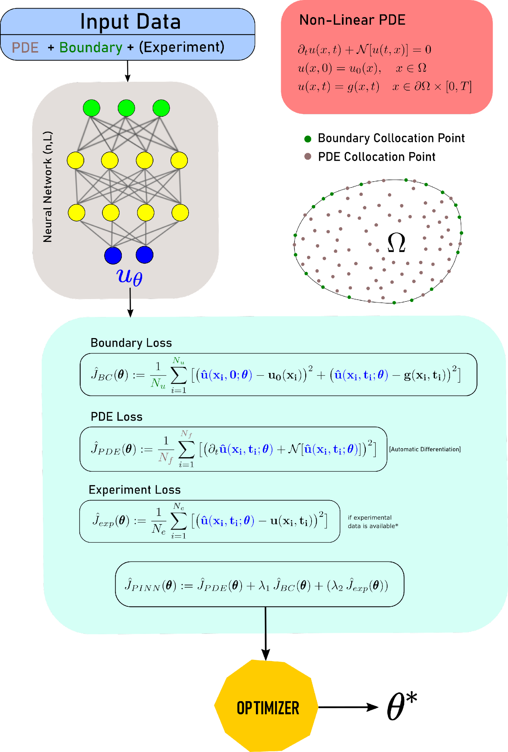
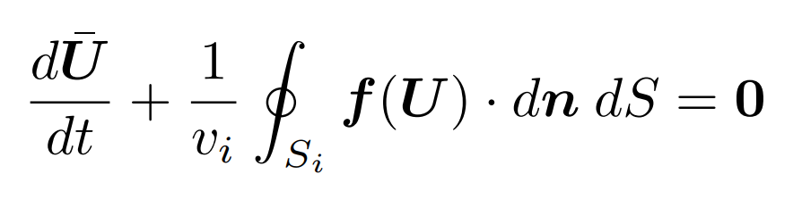
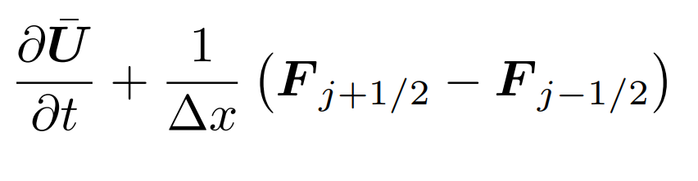
PDE Loss is problematic since it uses automatic differentiation
Solution?
Use central schemes (Finite Volume Methods) with Flux limiting
To approximate the PDE and then use this DIFF Loss

Slide 8
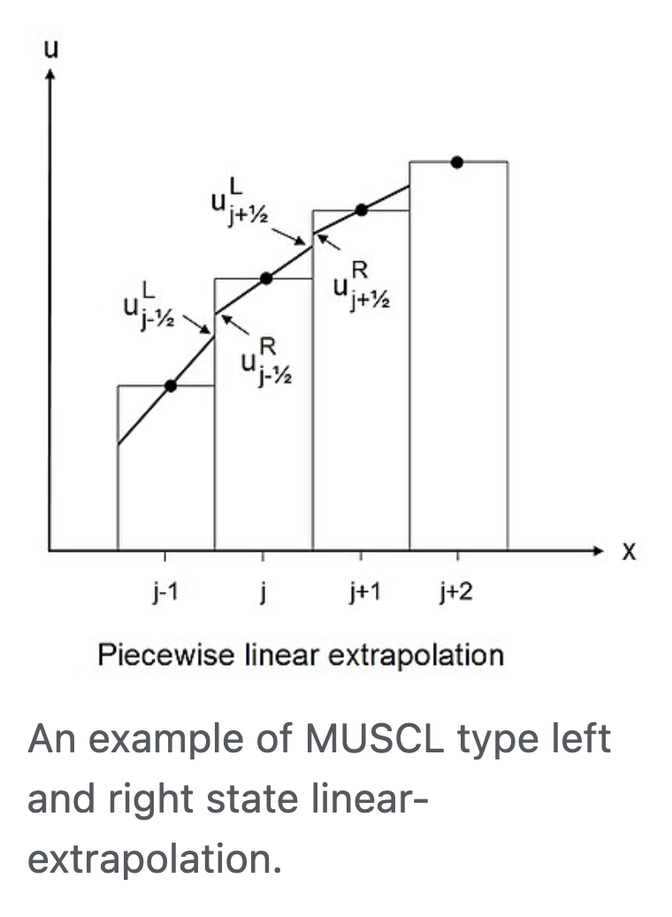
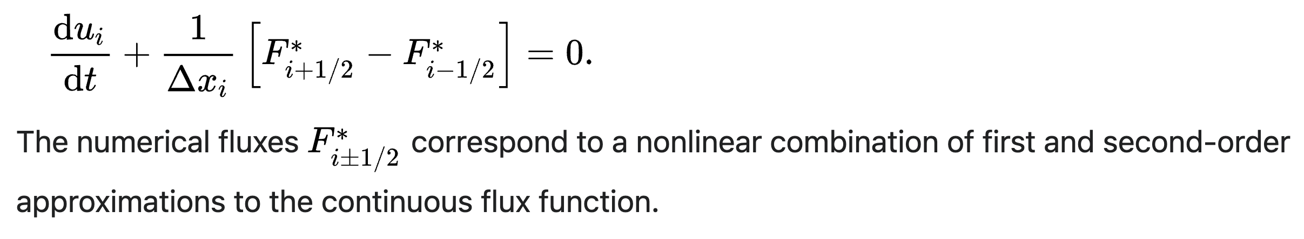
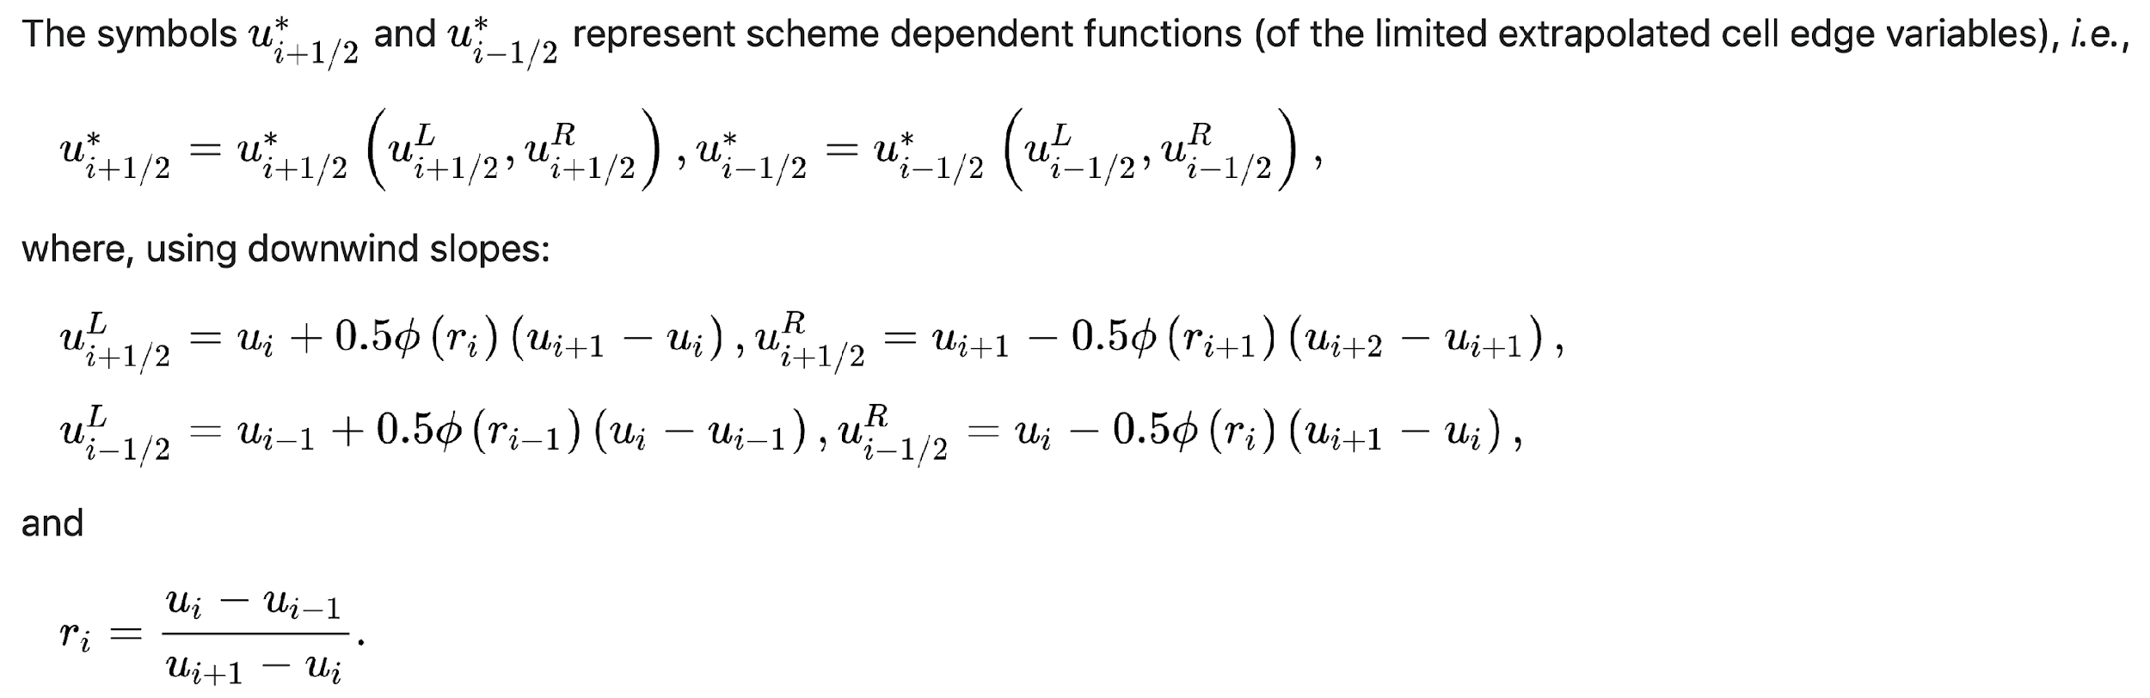
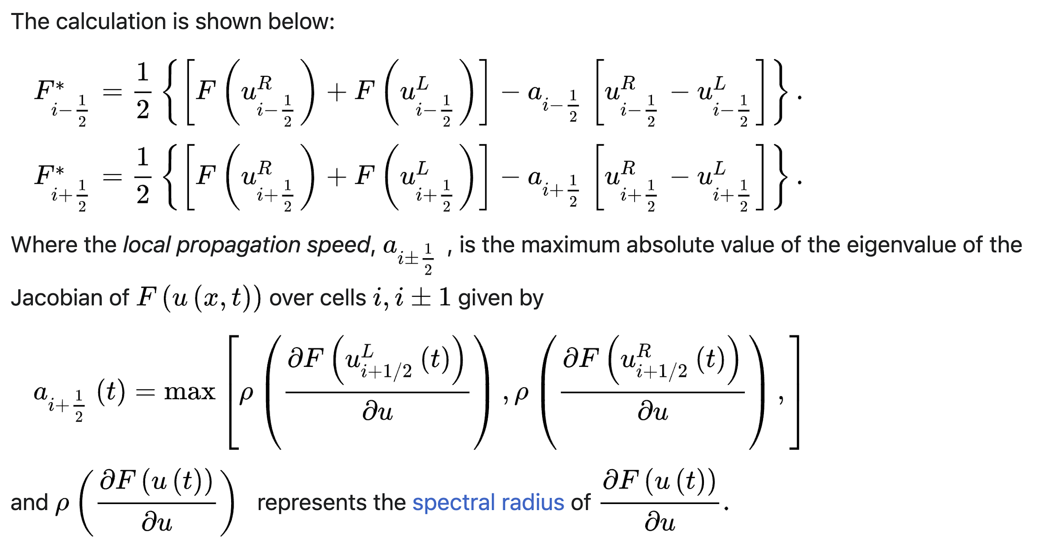
Finite Volume Methods with Flux Limiting
Source: https://en.m.wikipedia.org/wiki/MUSCL_scheme
Kurganov and Tadmor central scheme

Slide 9
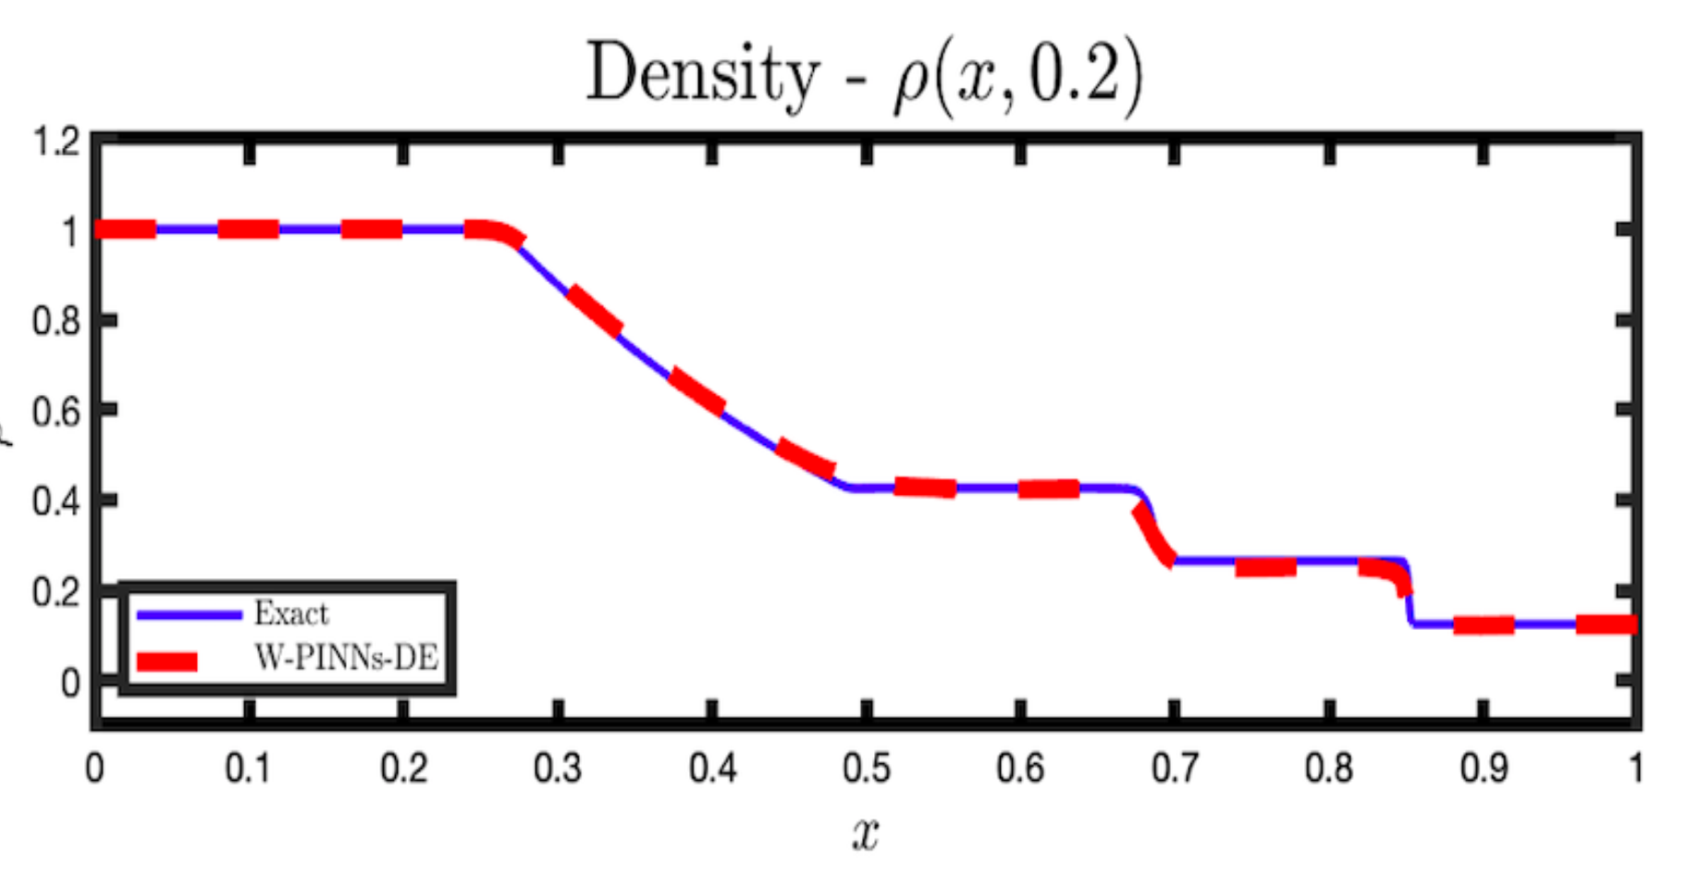
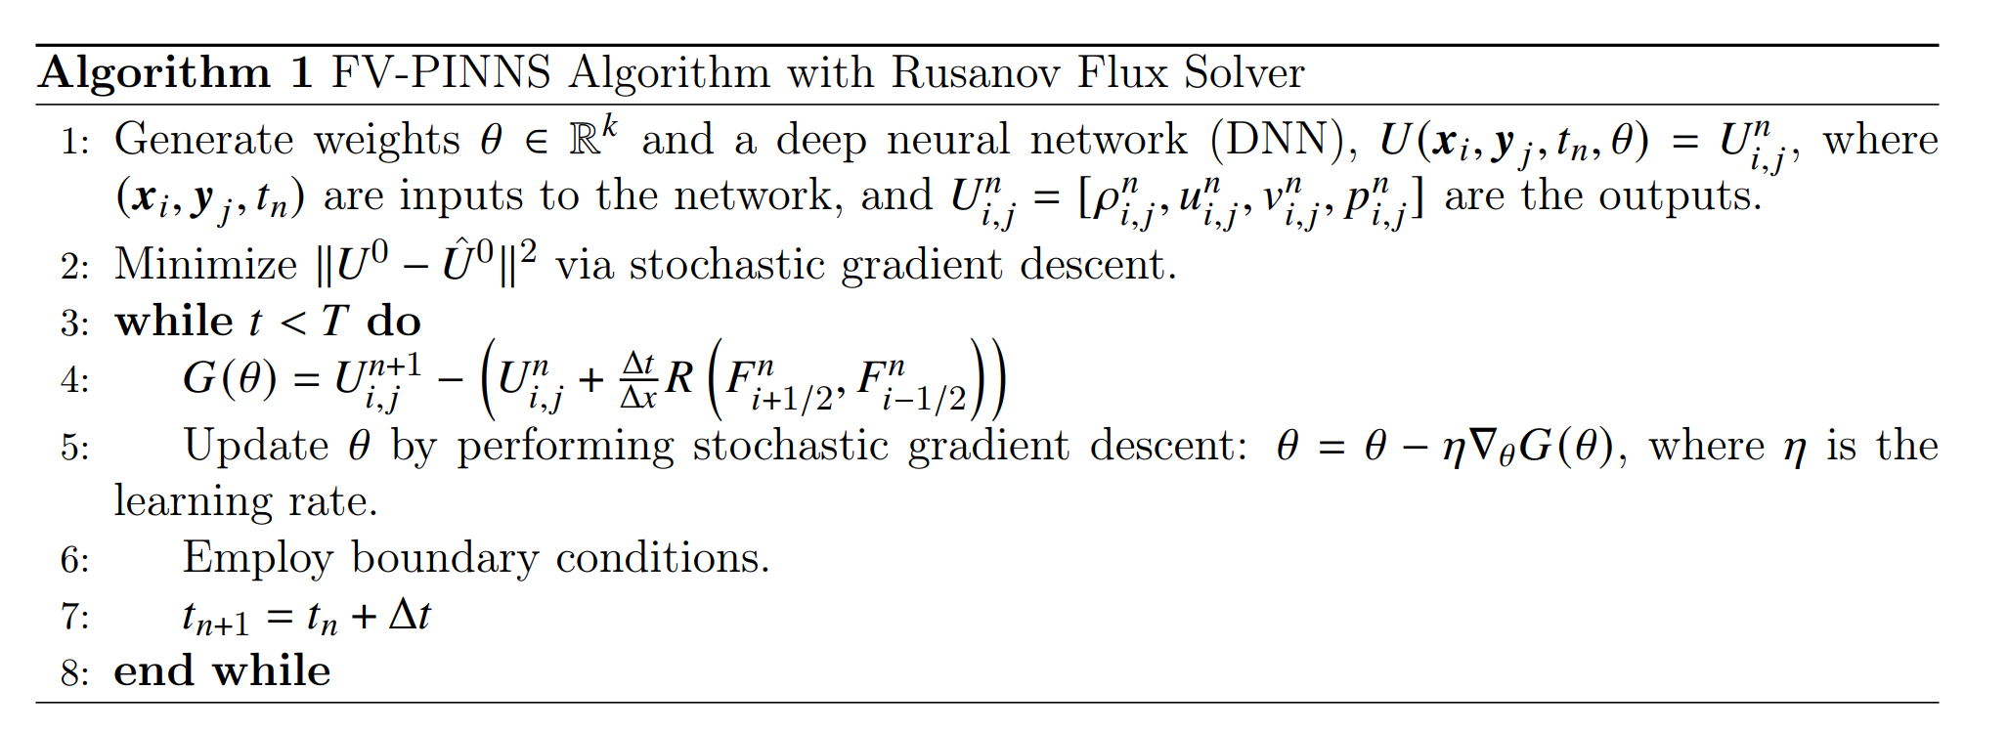
Finite Volume Physics Informed Neural Networks
“DIFF loss”
Exact
Algorithm
FV-PINNs
Solution to Sod Shock-Tube Problem with FV-PINNs

Slide 10
Results

Slide 11
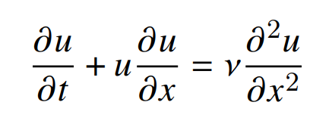
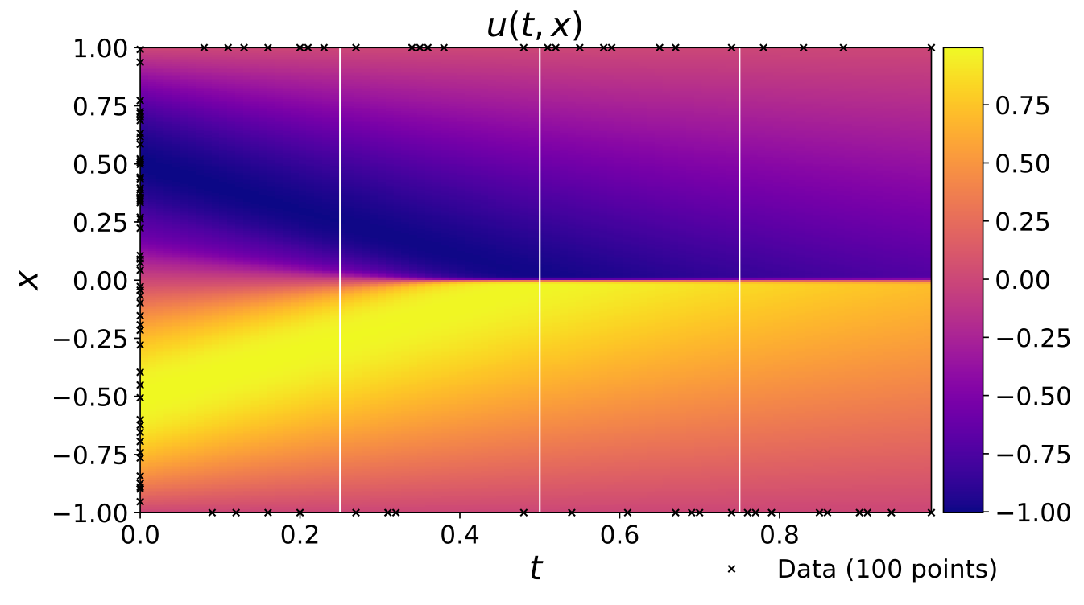
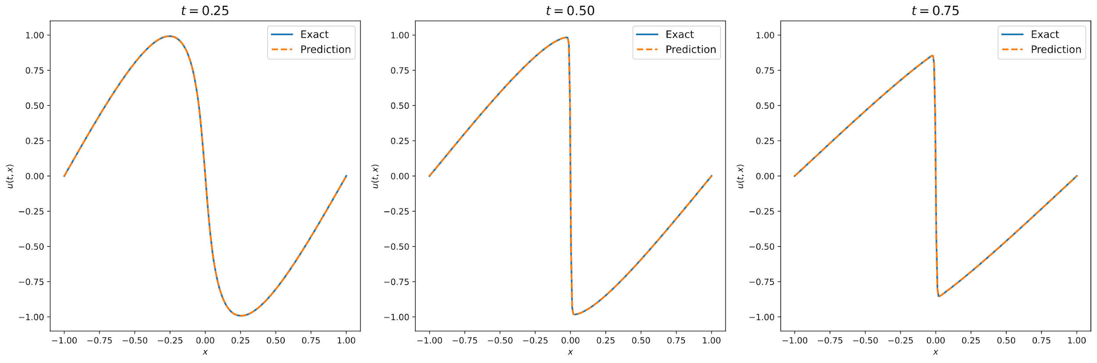
Burger’s Equation
Forward Problem

Slide 12
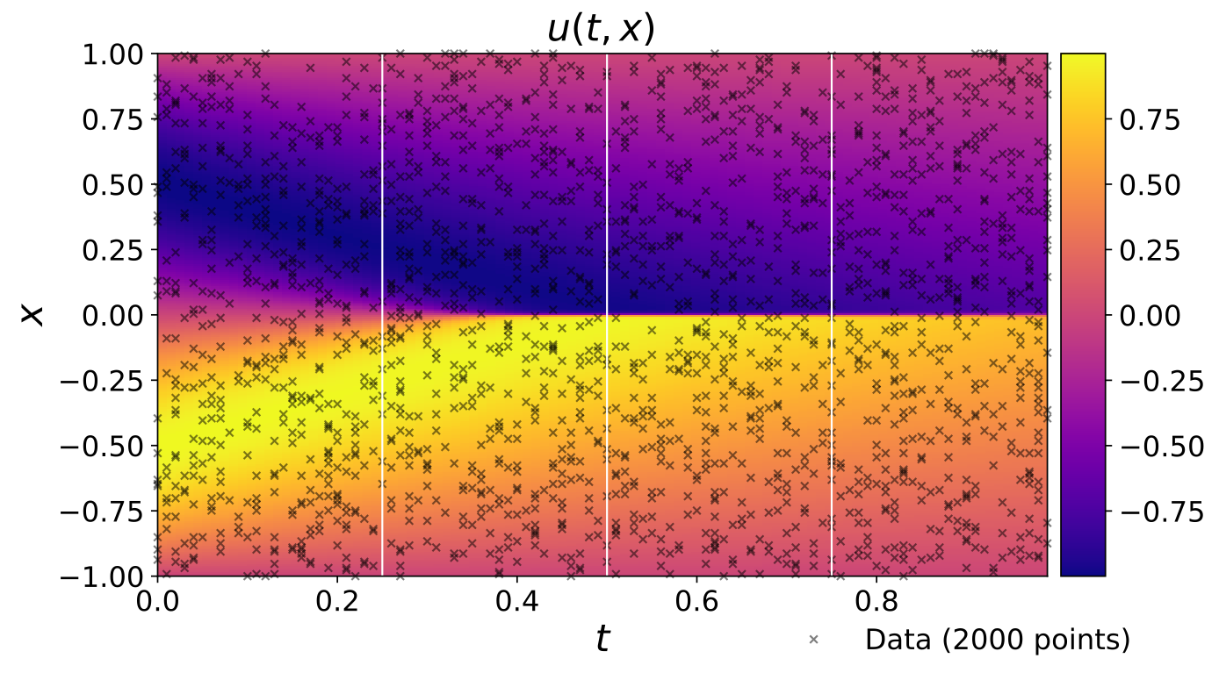
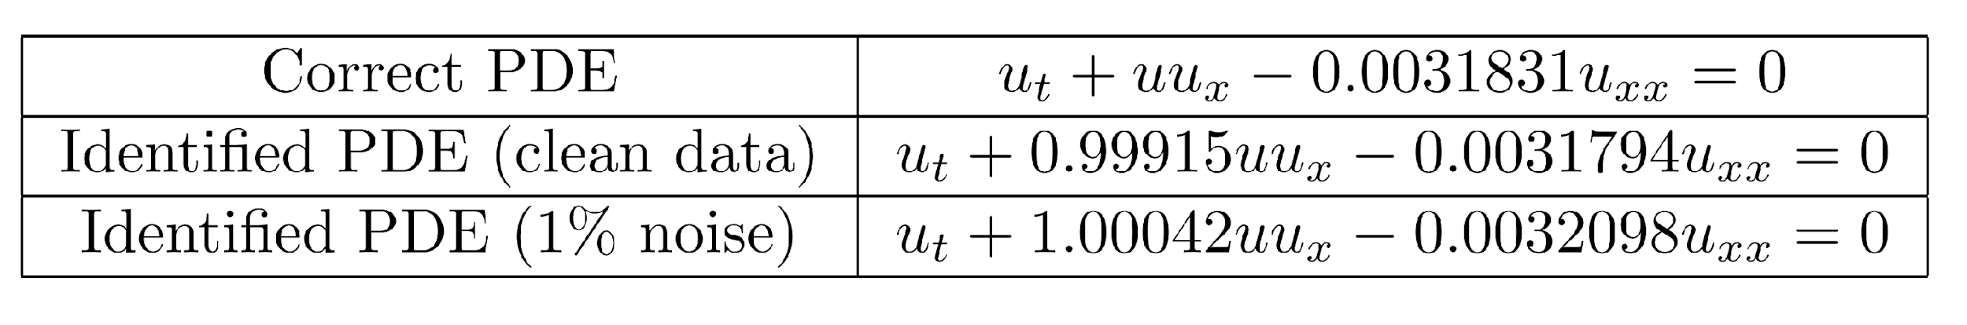
Burger’s Equation
Inverse Problem

Slide 13
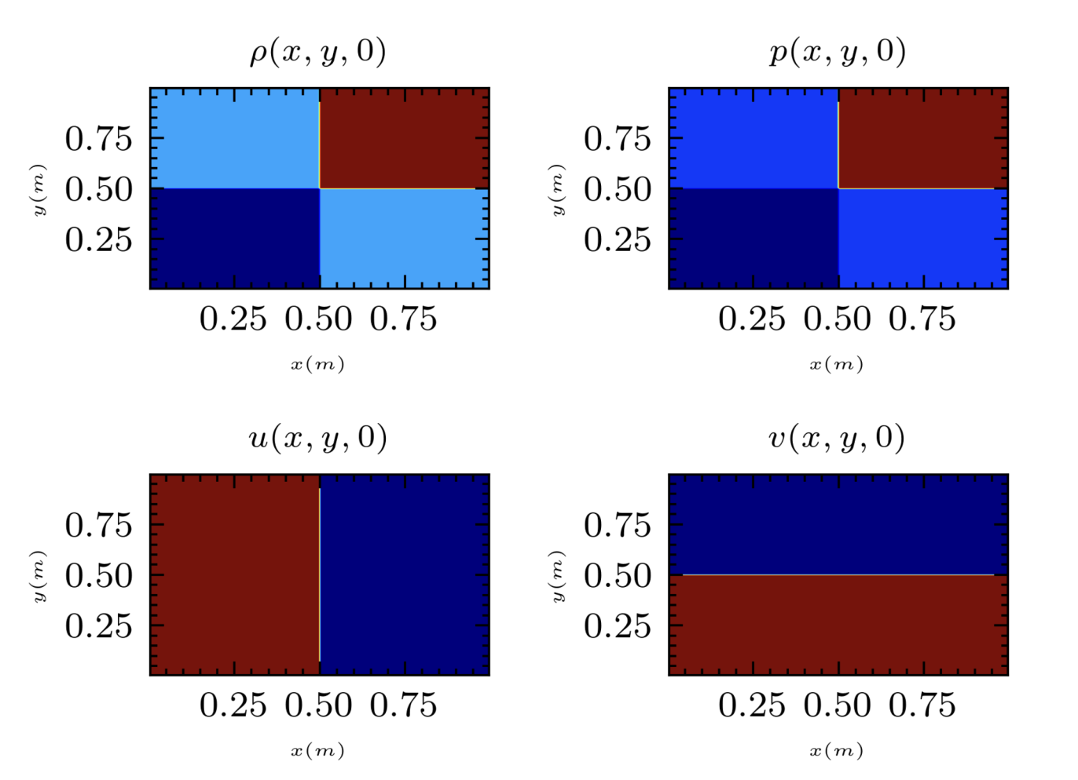

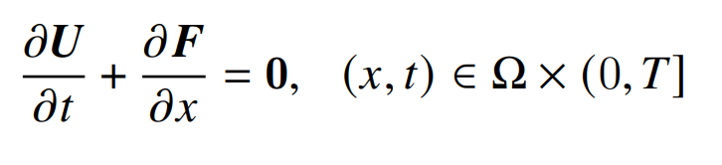
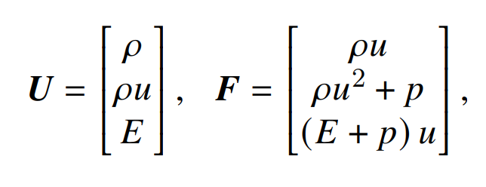
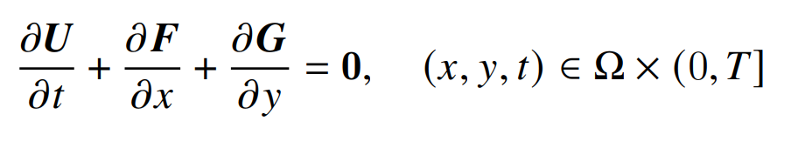
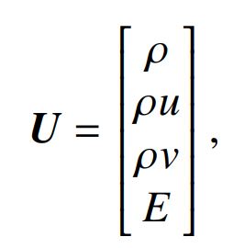
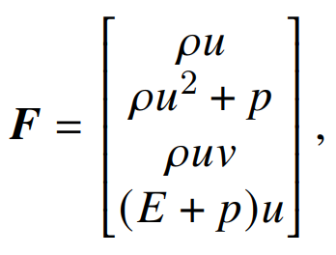
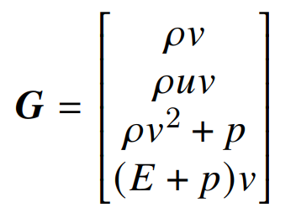
Euler Gas Equation (1D & 2D)
2D Liksa Shock-Tube
1D Sod Shock-Tube

Slide 14
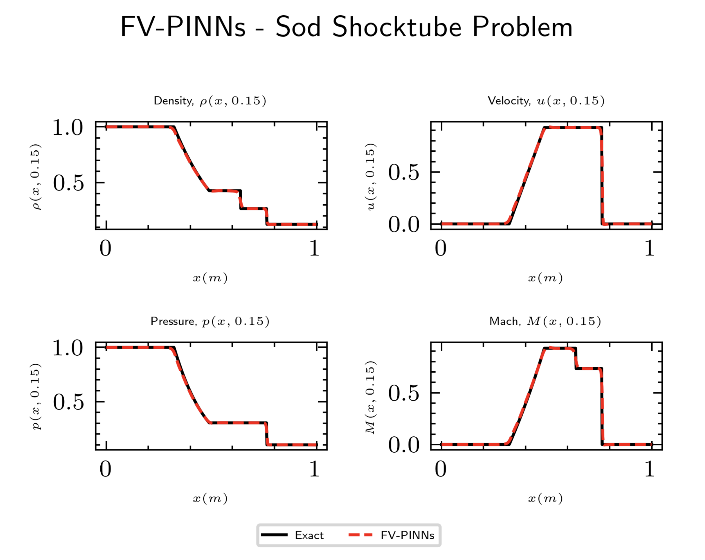
Euler Gas Equation (1D)
Results

Slide 15
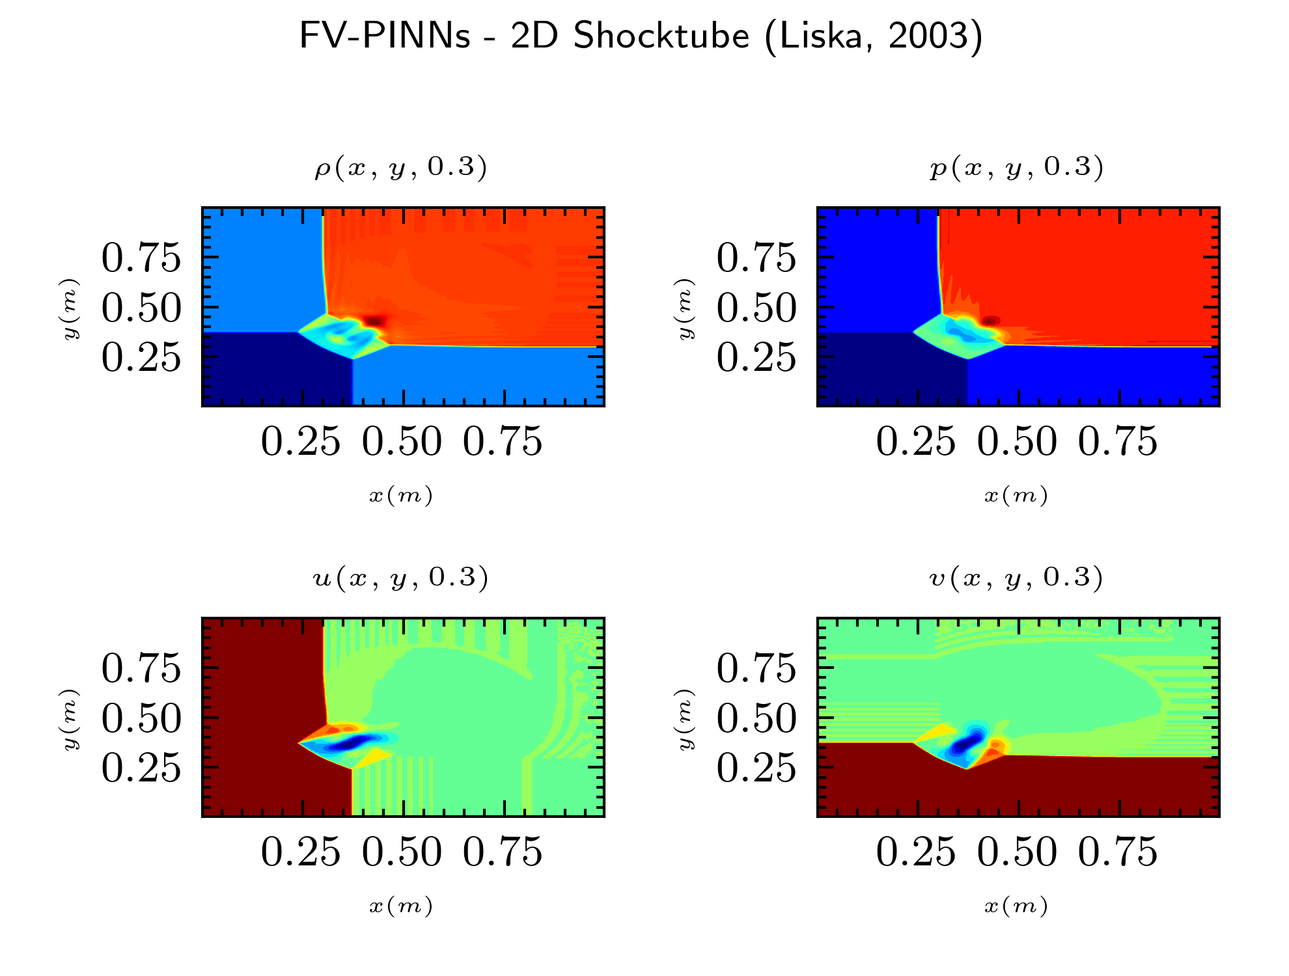
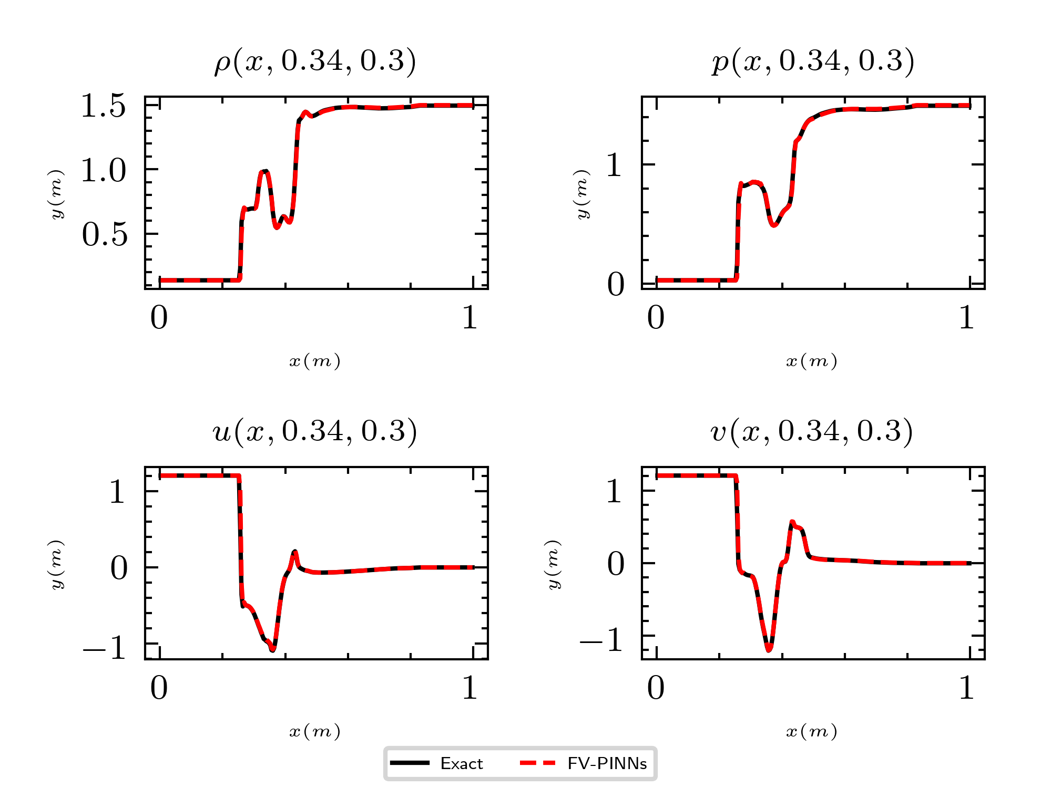
Euler Gas Equation (2D)
Results
Caption
Caption

Slide 16
Thank you for Listening!!!

